Slide 1
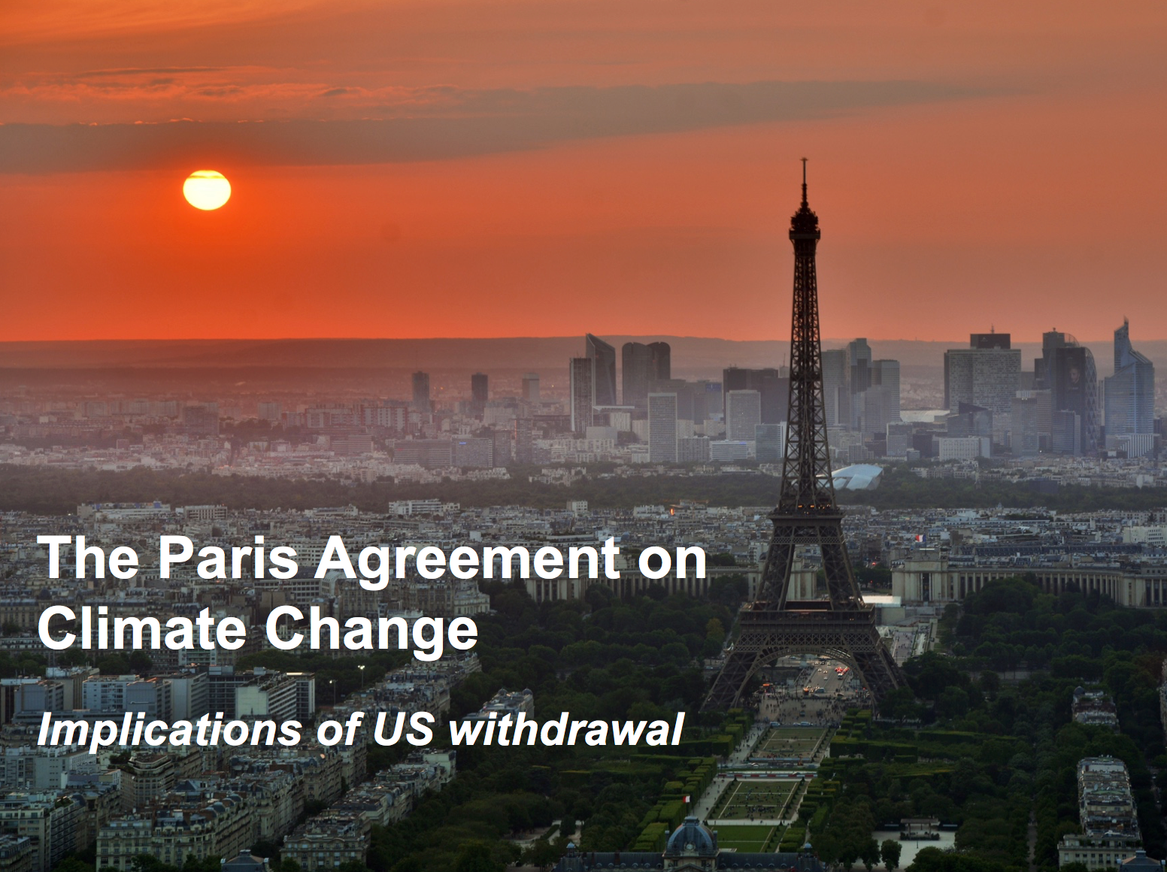

Slide 2



Three Climate Collision Courses
Greenhouse Gas (GHG) pollution is changing the composition of the atmosphere.
This has serious impacts on the environment and people.
The poor, and the marginalized are hit first and hardest.

Slide 3
Three Climate Collision Courses
Source: BSR / We Mean Business

Slide 4
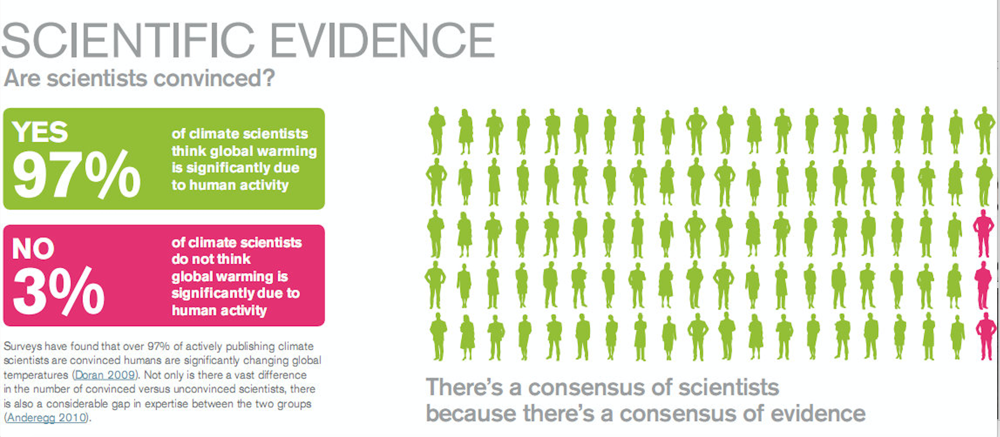
The scientific consensus
Source: skepticalscience.com
The “sum total of this evidence tells an unambiguous story: the planet is warming” and “the primary drivers are human in origin”. (US National Climate Assessment)
“Unequivocal, accelerating, and human induced” (IPCC)
32 national academies of science publish reports confirming scientific consensus.

Slide 5

The Paris Outcomes
The United Nations climate conference in Paris in December 2015 concluded with two major outcomes:
The Paris Agreement commits nations to holding global mean temperature rises to less than 2˚C above pre-industrial levels and contains 188 national climate action plans to bring this vision to life.
The Action Agenda includes commitments to GHG reductions from more than 4,000 companies, cities, regions and investors.

Slide 6
The Paris Agreement in 3 words
Unprecedented. The Paris Agreement is unlike anything that has come before in terms of level of ambition, volume of participation, leadership of key economies, and commitment to implement.
Defining. The implications for business and society are enormous. Policies and investments resulting from the Paris Agreement will reshape development paths, national economies, and value chains for companies across the globe
Immediate. The Agreement is already being translated into immediate action in countries and businesses around the world. The time to lead on this issue has arrived.

Slide 7
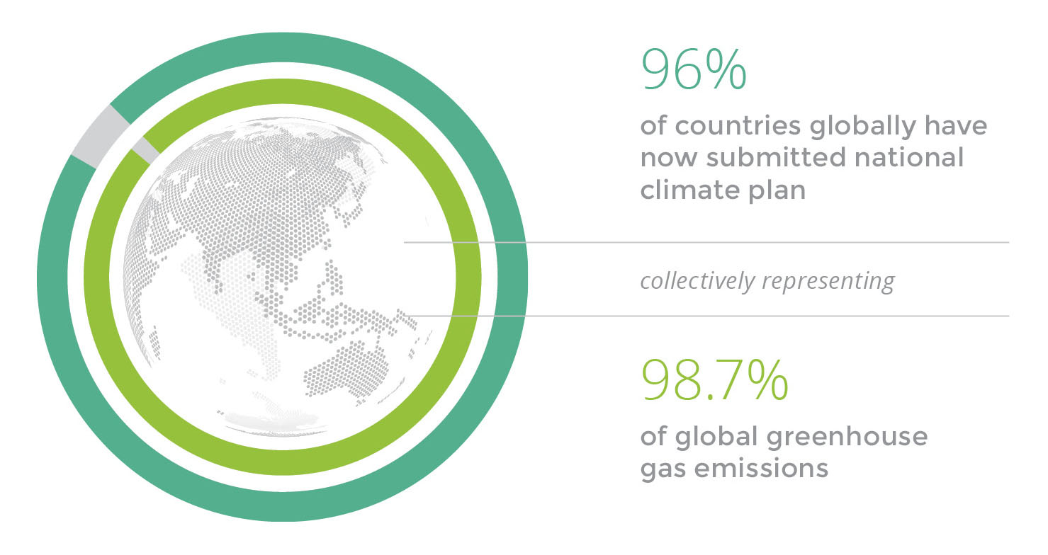
The Paris Agreement: Unprecedented
188 countries representing 98.7% of global GHGs submitted national climate plans (NDCs)
The United States committed to reduce GHG emissions by 26 to 28%.
The European Union committed to at least 40% GHG reductions by 2030 below 1990 levels
Source: BSR / We Mean Business
China agreed to peak the country’s carbon-dioxide emissions around 2030 and increase its non-fossil-fuel share of energy to around 20% by 2030

Slide 8
The Paris Agreement: Unprecedented
Source: BSR / We Mean Business

Slide 9
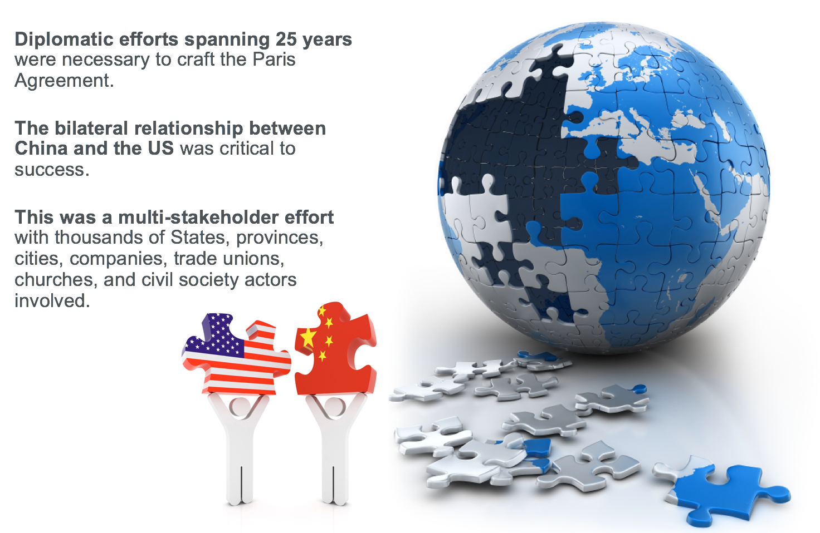
The Paris Agreement: Unprecedented

Slide 10
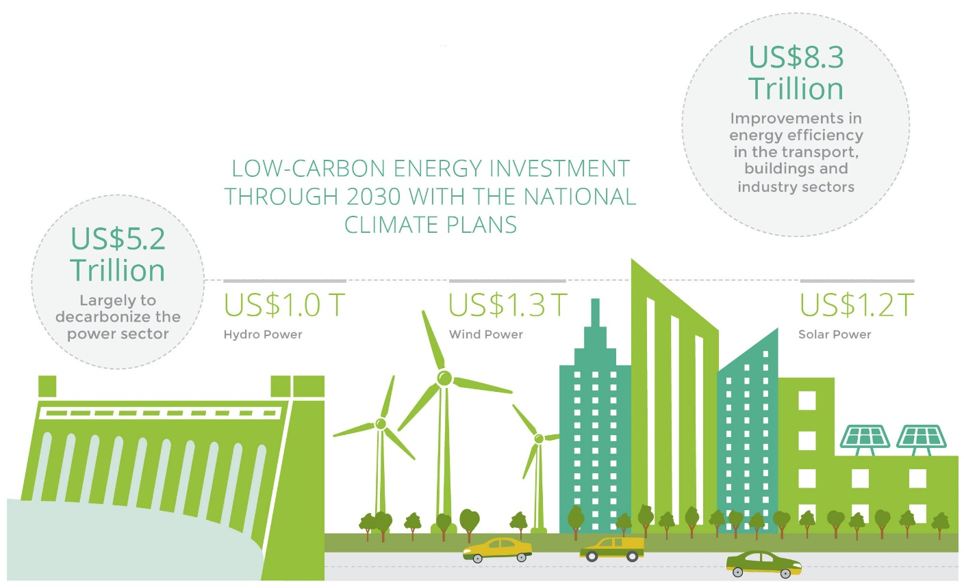
The Paris Agreement: Defining
All major economies are committing to restructuring their energy systems, changing transport patterns, and transforming infrastructure, buildings and land use.
Collectively, the national climate plans under the Paris Agreement represent at least a US$13.5 trillion market for the energy sector alone.
Source: BSR / We Mean Business

Slide 11
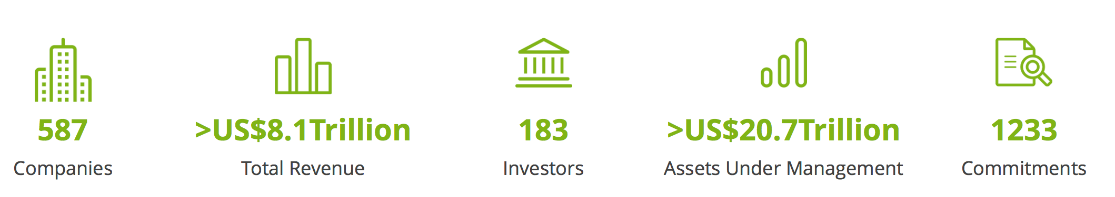
The Paris Agreement: Defining
Major multi-national companies are also leading on climate:
Source: We Mean Business
The largest private sector employer in the world has adopted science-based emissions reductions targets.
The four largest companies in the world in 2016 by market capitalization submitted amicus briefs to the Supreme Court in support of the Clean Power Plan.
Twenty-five companies bought full-page ads in The New York Times, The Wall Street Journal and The New York Post urging President Trump to remain in the Paris Agreement.
Thousands of American companies back the “Low Carbon USA initiative”.

Slide 12
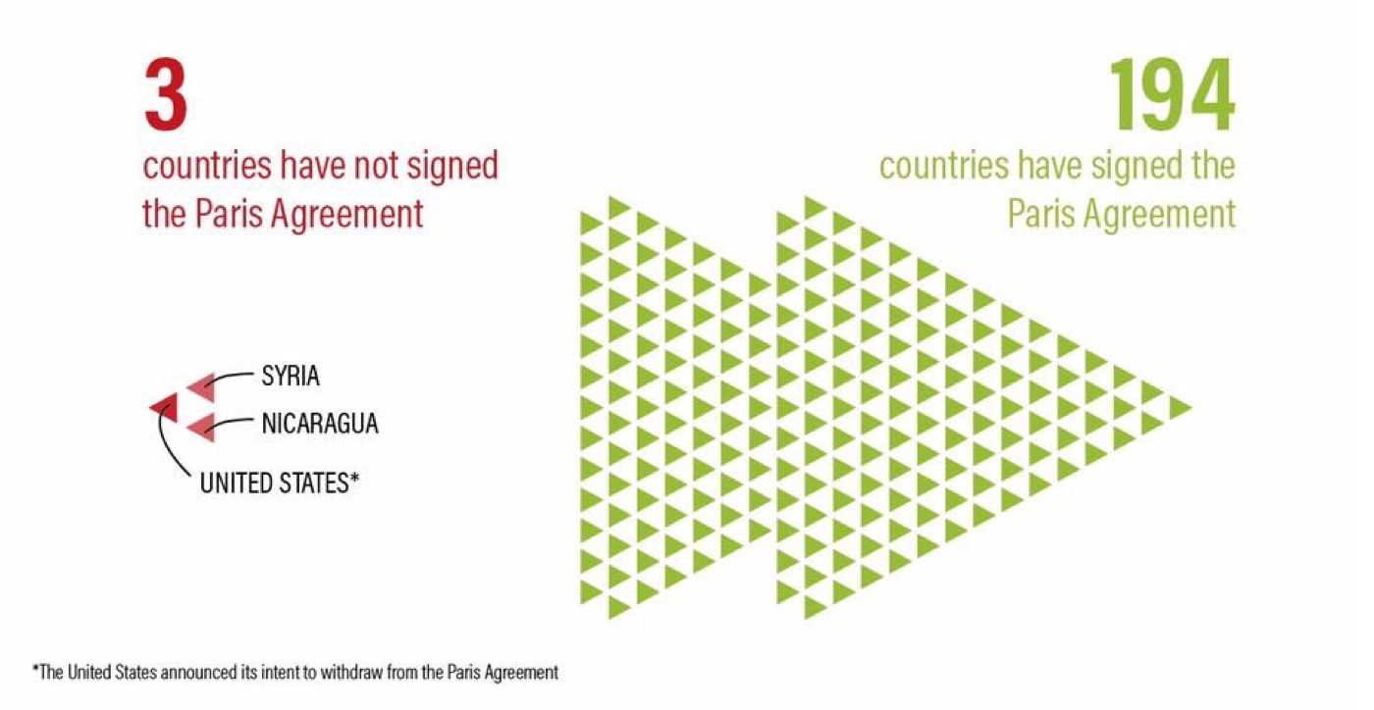
The Paris Agreement: Immediate
This includes 49 of the top 50 oil producers in the World.
This includes 39 of the top 40 coal producers in the World.
Source: World Resources Institute

Slide 13

US Withdrawal
The “What”, “Why” and “What’s next” of the “Trump withdrawal”

Slide 14





Scenario Planning for Trump
Decarbonization: Reducing emissions in the real economy.
Put the breaks on: Slow down climate action without causing irreparable long-term harm.
Diplomacy: Shaping domestic and international policy and working with the rest of the international community.
Pull the wheels off: Undermine climate action indefinitely with the potential for lasting harm..
Discourse: Influencing how we think about climate change through their communications, behavior, funding and research.

Slide 15
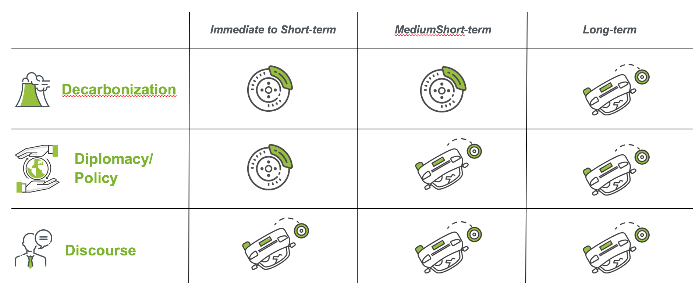
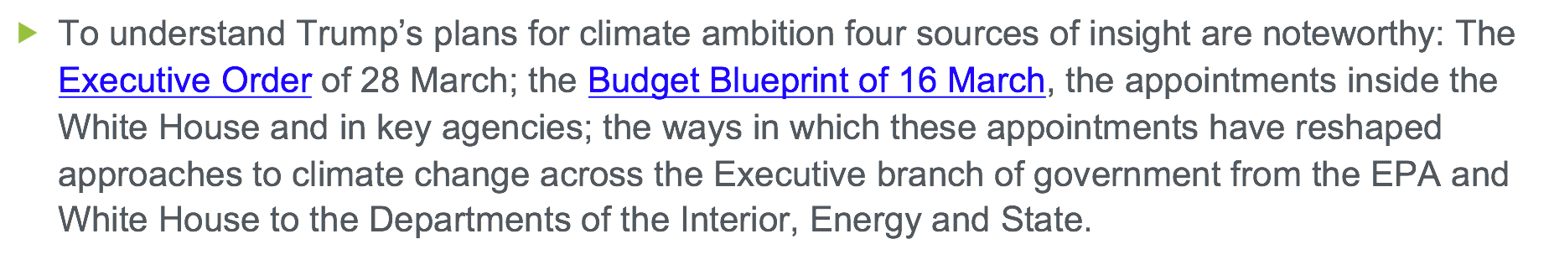
Scenario Planning for Trump

Slide 16
Why? Climate and Jobs
Source: BSR / We Mean Business

Slide 17
Why? Climate and Coal
Source: BSR / We Mean Business

Slide 18
What happens next?
Distributed Leadership at home. Isolation overseas.
23 States are committed to implementing / supporting the Paris Agreement.
Thousands of US mayors, governors, college and university leaders, businesses, and investors have joined forces in the “We’re still in” coalition.
The rest of the world is committed to moving ahead.
The Marrakech Action Proclamation of 2016
The G7 and G20 Leaders Declarations in Summer 2017

Slide 19
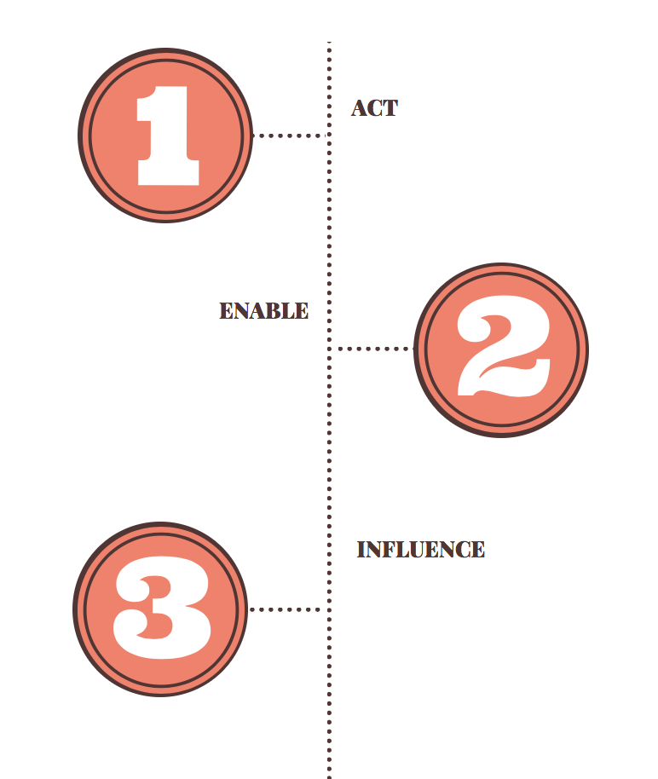
What can you do?
Act. Take steps to reduce your own GHG emissions. Think about your energy use and mix; your diet; your transportation.
Enable. Educate and support others to act within your household, workplace and community. Build a vocabulary of arguments to appeal to other’s who may be new to climate change.
Influence. The greatest assets you have are your vote and your power as a consumer. Insist that your elected officials need to stand-up for climate ambition. Demand action on climate change from the companies you buy from and invest in.

Slide 20
Reading and Resources
The Global Warming Reader: A Century of Writing About Climate Change by Bill Mckibben
Nature's Economy: A History of Ecological Ideas (Studies in Environment and History) by Donald Worster
The Signal and the Noise: Why So Many Predictions Fail--but Some Don't by Nate Silver
The Climate War: True Believers, Power Brokers, and the Fight to Save the Earth by Eric Pooley
Dark Money: The Hidden History of the Billionaires Behind the Rise of the Radical Right by Jane Mayer
The Impossible Will Take a Little While: Perseverance and Hope in Troubled Times by Paul Rogat Loeb

Slide 21
Questions are welcome!
Edward Cameron, PhD
www.cameronclimate.com
edward@cameronclimate.com

